Slide 1
Vehicle Routing Problem with Loading Constraints
Group 9
Xuanyu Zhao a1655611
Yawen Luo a1657343
Wei Zhang a1657881
Supervisor: Sergey Polyakovskiy

Slide 2
Outline
Overview
Introduction
Project Aims
Approach
Results
Future Work
Lesson learnt
Statistics
Acknowledgement
Notes:
In the final presentation, we would expect to see a brief overview of the product, why it‘s necessary, what you were planning to achieve, reflection on your journey including lessons learnt and peer feedback etc.

Slide 3
Overview
2L-HFVRP
the heterogeneous ﬂeet vehicle routing problems with
two-dimensional loading constraints _{[1]}
Loading of freight into vehicles
Successive routing of the vehicles to satisfy customer demand
Outcomes
An approximate solution
Software with GUI
Potential to benefit everyone’s life in the future

Slide 4
Introduction
Customer Needs
Logistics companies expect to have optimized routes e.g. Cargo distribution for large supermarket
no mature or applicable applications with GUI in the software market
Project Tasks
Find an approximate solution
Develop software with GUI
Necessary documentation

Slide 5
Project Amis
Algorithm
Should minimize total distance of all routes
Software
Read an input instance
Propose approximately optimal routes in graphical mode
Team Building
Cooperate closely

Slide 6
Approaches
Terms and Definitions
[Depot]: The warehouse. Starting and ending point of a route.
[Customer]: An entity with fixed location and fixed amount of items to receive.
[Vehicle Type]: A specific type of vehicle with certain size, capacity and fixed / variable cost.
[Route]: The route of a vehicle for delivering items to customers, starting from depot, serving one or more customers in fixed sequence and finally ending at depot.

Slide 7
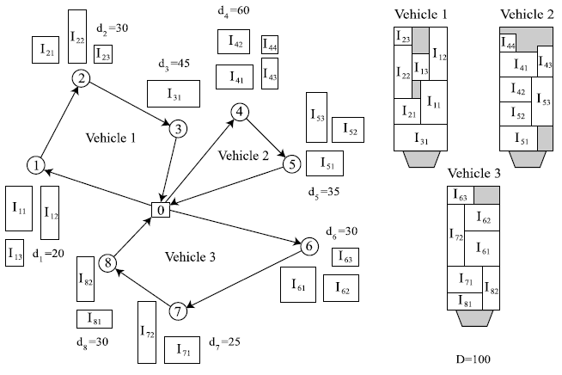
Approaches
[2]

Slide 8
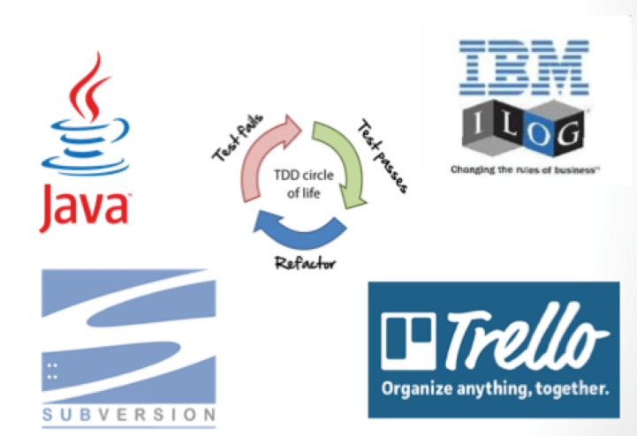
Technology and Tools
Linkern.exe: calculate TSP route

Slide 9
Approaches
Algorithm development
Multi-agent system for VRP part _{［3］}
Bin packing heuristics for checking packing feasibility _{［4］}
Packing heuristics based Mixed Integer Programs

Slide 10
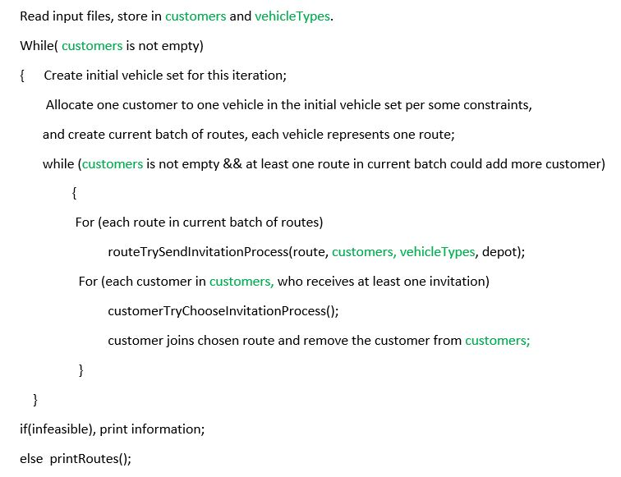

Slide 11
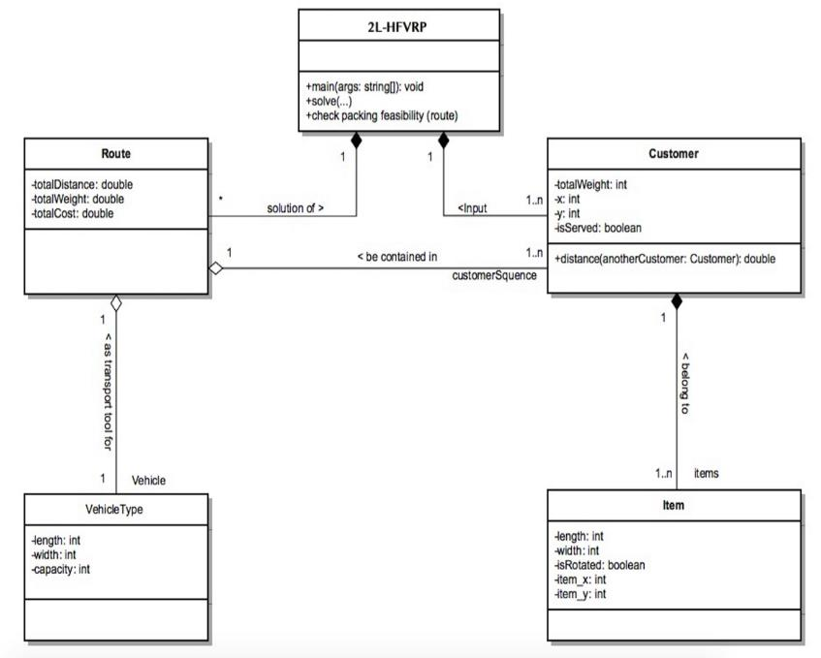

Slide 12
Software Development Process
Design and planning
Algorithm and software development
Experiment and testing
Maintaining

Slide 13
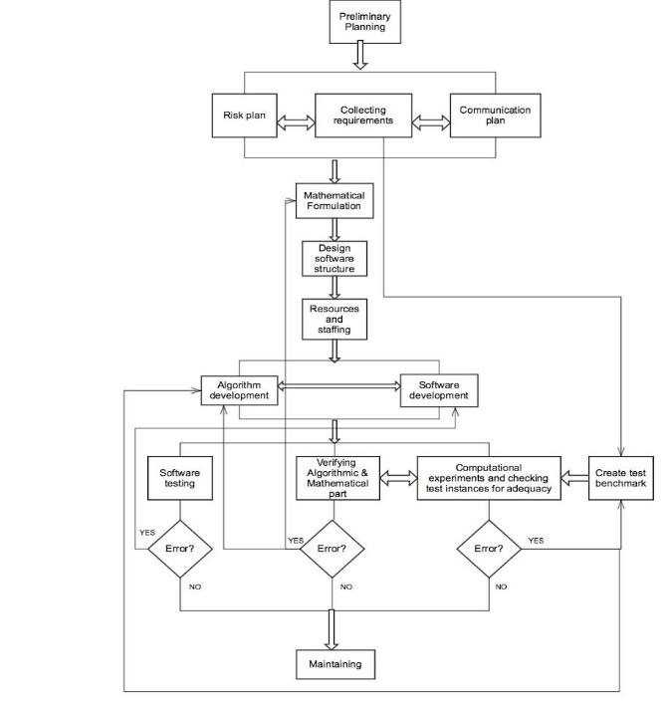

Slide 14
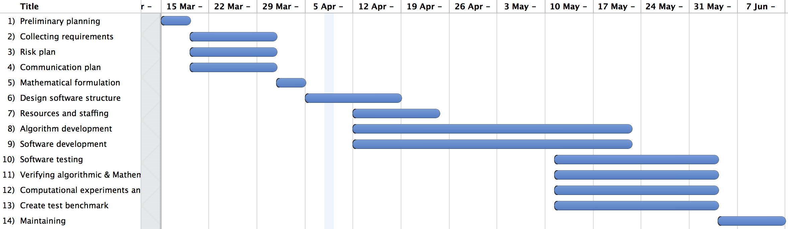
Project Schedule

Slide 15
Changes Happened
Completion of development of algorithm and software was delayed for one week
Discard 2 constraints
Sequential Loading
Item Rotation
Same type vehicles changed to heterogeneous types
Notes:
Development of algorithm and software was delayed for one week
Discard 2 constraints
Same type vehicles changed to heterogeneous types

Slide 16
Online Project Management
Continuously work with SVN repository provided by Dr Sergey – from revision 30 to revision 146
Web application for PM – Trello
Backup all data in Google Drive

Slide 17
Test
Algorithm verifying
Computational experiments
GUI functionality test

Slide 18
Results
Solution to the problem
Cope with test instances from 15 items for 15 customers to 786 items for 255 customers
Generates stable and reliable results
Robustness proved by passing 360 test instances

Slide 19
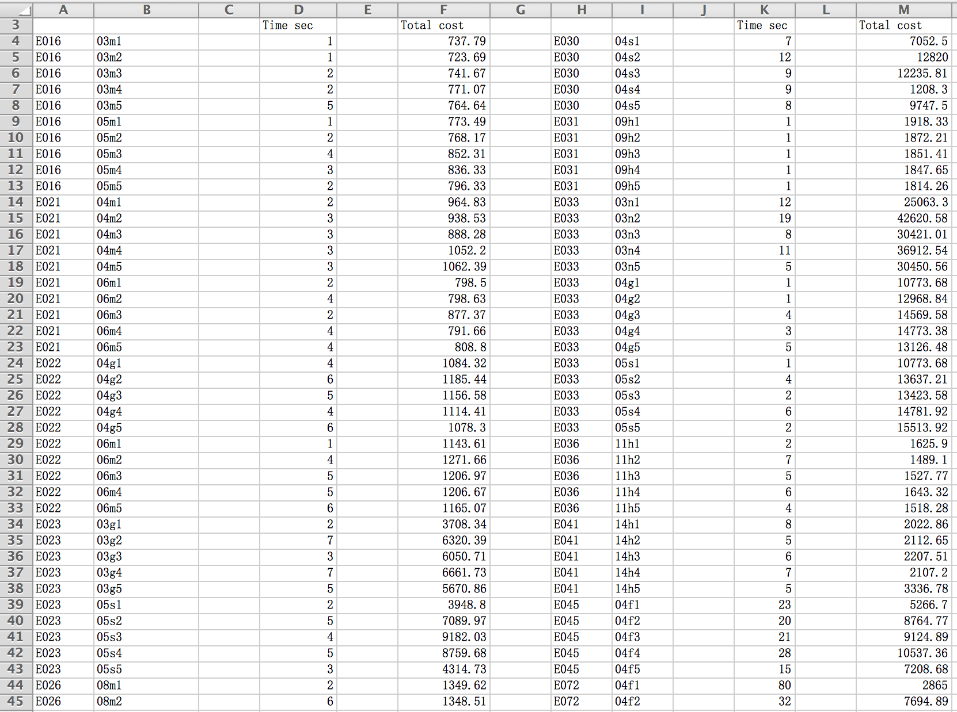

Slide 20
Results
Software with GUI
Utilize our solution
Present results in graphical mode
Provide a user manual

Slide 21
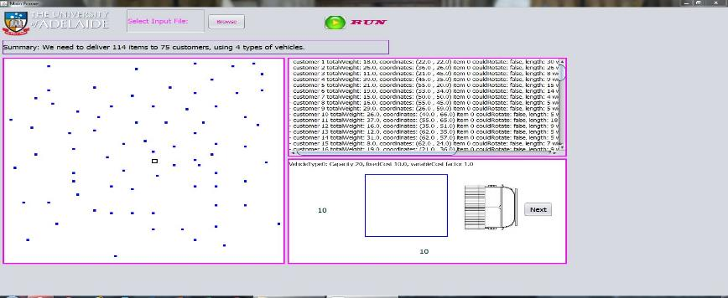
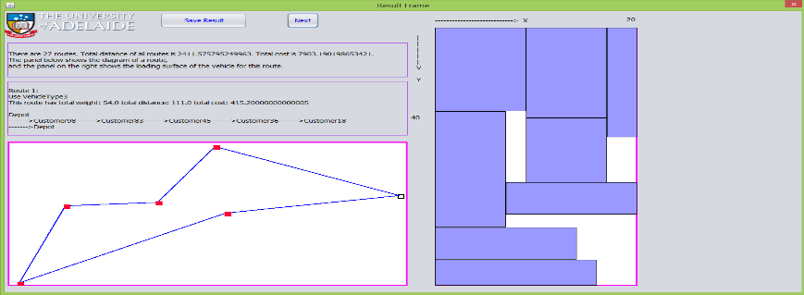

Slide 22
Future Work
Find some real-world logistics companies to try our software
Add sequential loading and item rotation constraints
Use real road distance instead of Euclidean distance

Slide 23
Lesson learnt
Faster packing heuristics could reduce running time
GUI develop skills
How to work in team
Software design is more important than implementation

Slide 24
Peer-review Feedback
Hard to understand the algorithm
Correction: provide the pseudo code
Need to provide a GUI
Correction: Design GUI architecture
Design GUI layout
Integrate GUI with algorithm part
Test GUI

Slide 25
How to work in team
Improve efficiency of meetings
Master effective communication methods
Treat group members’ criticism seriously
Set a special schedule monitor
Allocate tasks clearly and help each other

Slide 26
Statistics
Reading 15 previous research papers
16 official meetings with supervisor
> 50 group meetings
> 1300 working hours (whole group)
> 4000 lines code (part provided by Dr Sergey)
> 500 times test

Slide 27
Member Contribution
Xuanyu Zhao:
- Leading: mathematical formulation & software structure
design & algorithm / software development
- Participating: documentation, test and maintaining
Wei Zhang:
- Leading: test and maintaining
- Participating: design, algorithm / software development,
documentation
Yawen Luo:
- Leading: documentation, group schedule monitoring,
- Participating: design, algorithm / software development, test
and maintaining

Slide 28
Acknowledgement
Thank Dr Sergey Polyakovskiy, Dr Amali Weerasinghe and Mr Kevin MacIunas, for presenting us with the opportunity to take on this project and the guidance they have provided.
Thank MCI classmate and friends for helping us.

Slide 29
References
[1]. Leung S, et al, 2013, ‘A meta-heuristic algorithm for heterogeneous fleet vehicle routing problems with two-dimensional loading constraints’.
[2]. Iori, M., & Martello, S, 2010, ‘Routing problems with loading constraints’, TOP, 18, 4–27.
[3]. Polyakovsky S & M’Hallah R, 2013, ‘A muti-agent system for the weighted earliness tardiness parallel machine problem’.
[4]. Polyakovsky S & M’Hallah R, 2007 ‘An agent-base approach to the two-dimensional guillotine bin paking problem’, European Journal of Operational Research, 192,767-781.

